Slide 1

Provincial waters
Mirco CAZZARO and Nicola BOSCOLO CEGION proudly presents
GEOGAPHIC INFORMATION SYSTEMS
UNIVERSITY OF PADUA – A.A. 2022/2023

Slide 2
The problem
Control
1
The province of Belluno wants to know the situation of the water bodies
Manage
2
Manage the inputs of potentially polluting liquids
3
Monitoring
Monitoring the status of the provincial waters

Slide 3
The requirements
Management of hydrography
Management of intakes
Management of water conditions
Consultation of data
Maintenance of control units
Detection of possible emergencies
Consultation of data
Management of alerts by citizens

Slide 4
Current situation
Management Information System
Topographic database
Based on PostgreSQL
With no GIS extensions
The region to which the province belongs provides topographic data with a WMS service

Slide 5
Management of hydrography
Import and Export
data in shape format and other standard formats
Interrogation of the DBMS
Spatial and alphanumeric filters combined and export of the query results
Feature proof
Possibility of updating the network and historicization of the changes
Visualization
Cartography and orthophoto as background

Slide 6
Management of intakes
Knowledge
know the position of the intakes and their attributes
Management
insert new intakes and remove the abandoned ones
Pollutants routes
determine the route of any pollutants released

Slide 7
Management of water conditions And maintenance of control units
Management of monitoring units
There are 90 units located in rivers
And 21 in the lakes
They need periodic maintenance, it must be schedule and record the execution
What data they collect
− Level, speed and water flow
− Turbidity, temperature, conductivity
− Ph
− Redox potential
− Dissolved oxygen
− NH4+
− CL-

Slide 8
Detection of possible emergencies
Notification
Technicians support
The system must send a emergency notification if parameters are out of chart
They must be able to:
− identify possible sources of input in order to intervene immediately
− identify the water bodies (rivers, lakes, streams, ...) affected by pollution to be
able to issue the necessary alarms

Slide 9
Management of alerts by citizens
Citizen alerts
Report filtering
Citizen can send reports of malicious behaviour and alterations of water
By using a web portal can send a report with the location where he found something wrong and some notes and even a photo.
By a using a third part software a technician must fund the first 3 nearest monitor units, 1 upstream of the river and 2 in the downstream.
Then the software must find all the near reports in a range of 500m

Slide 10


Database

Slide 11
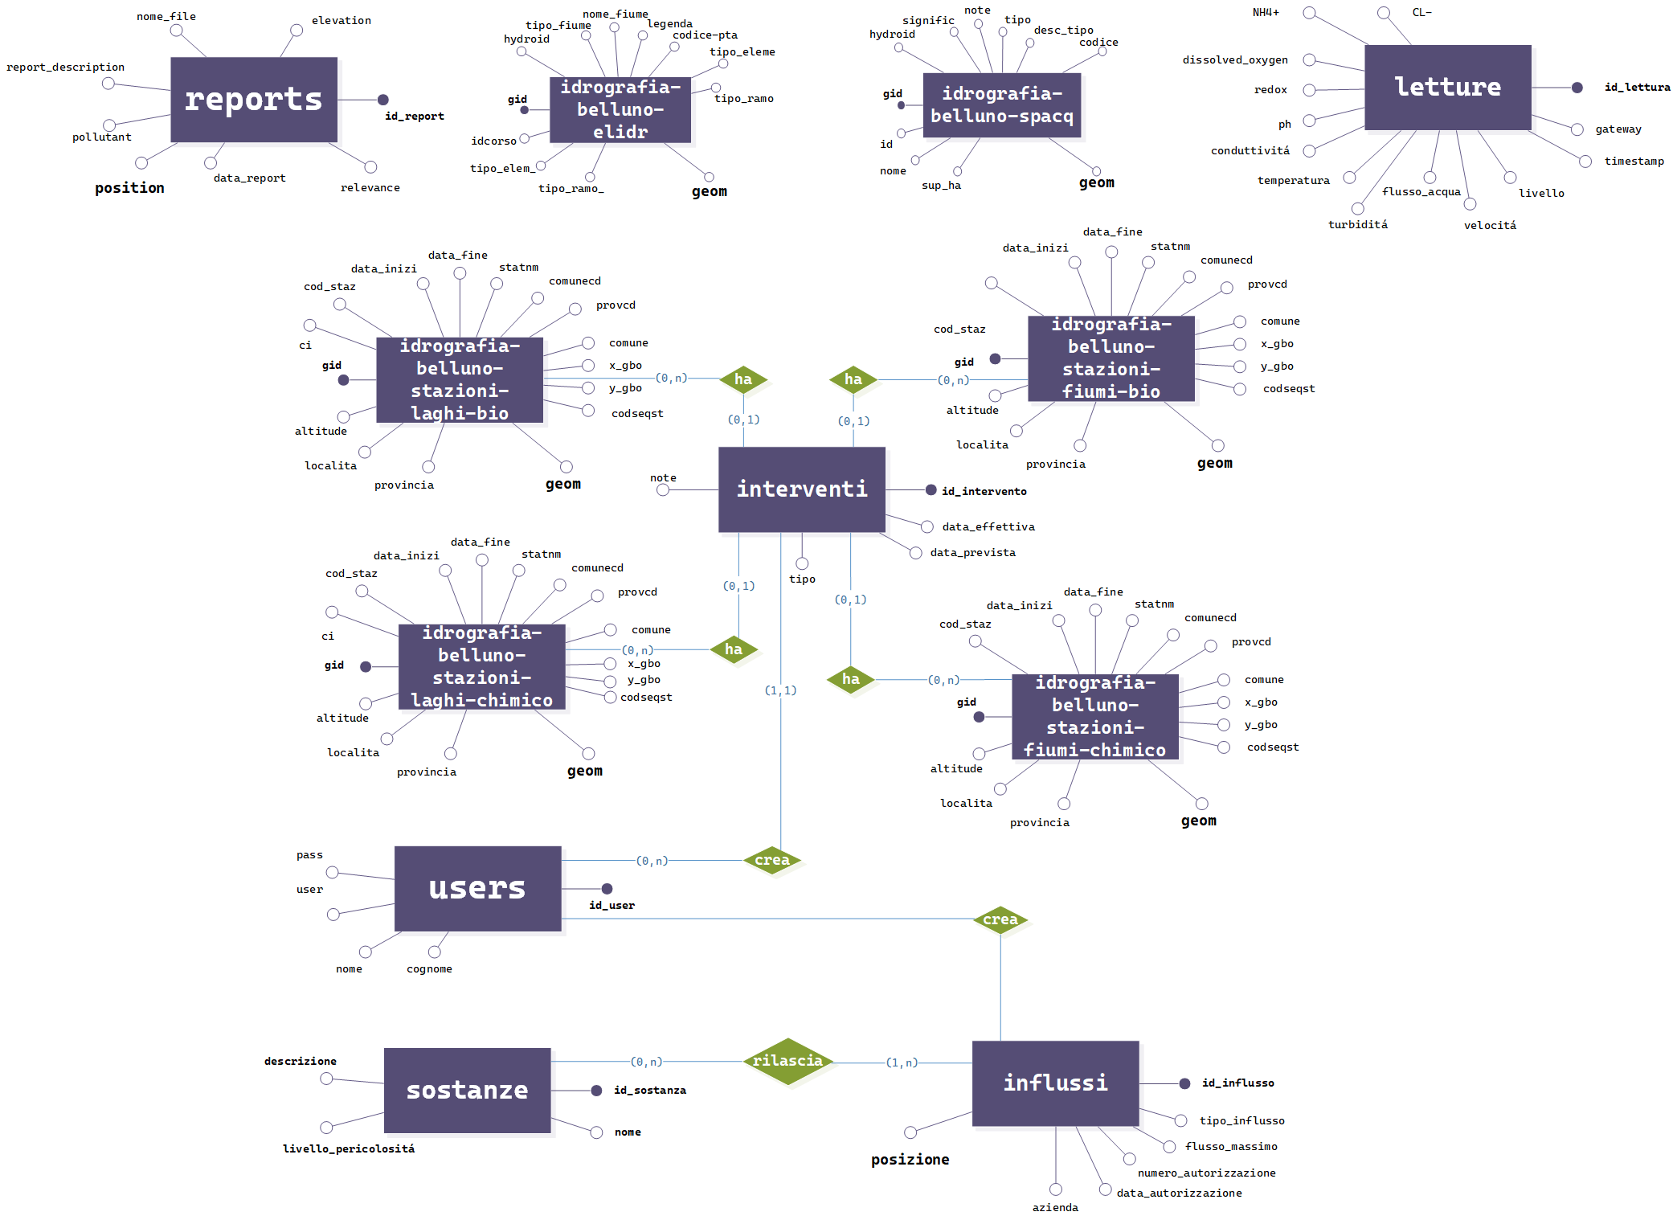

Slide 12
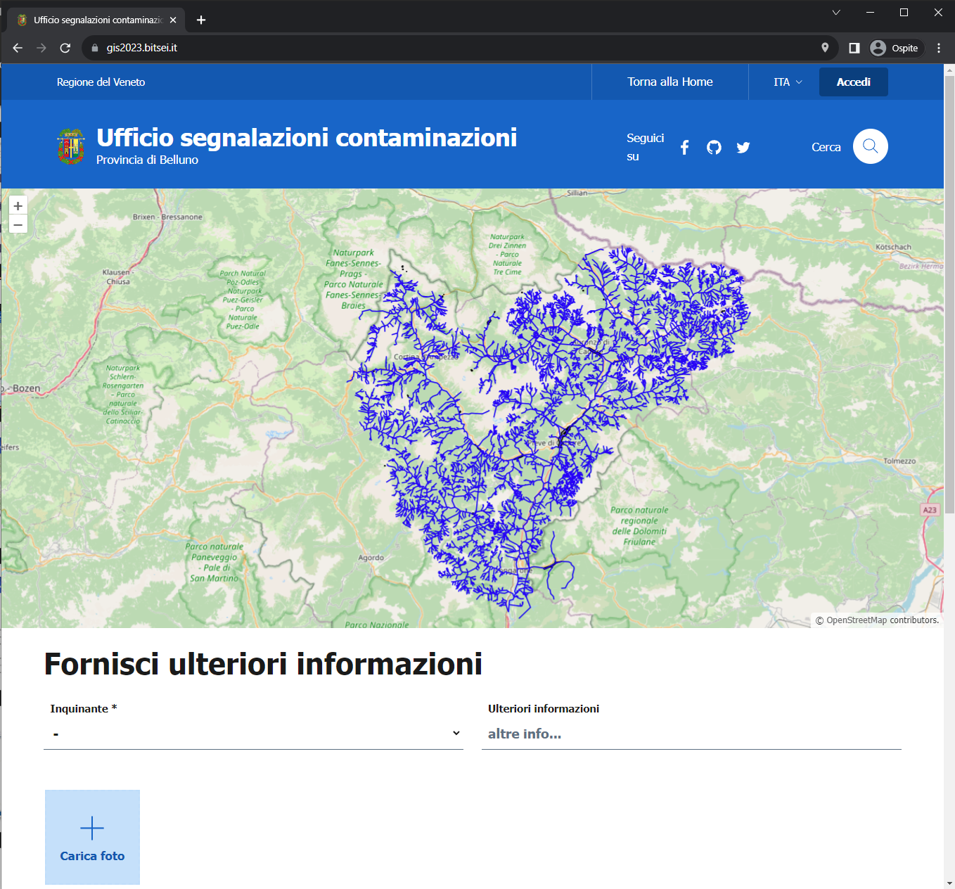

Project softwares
gis2023.bitsei.it

Slide 13
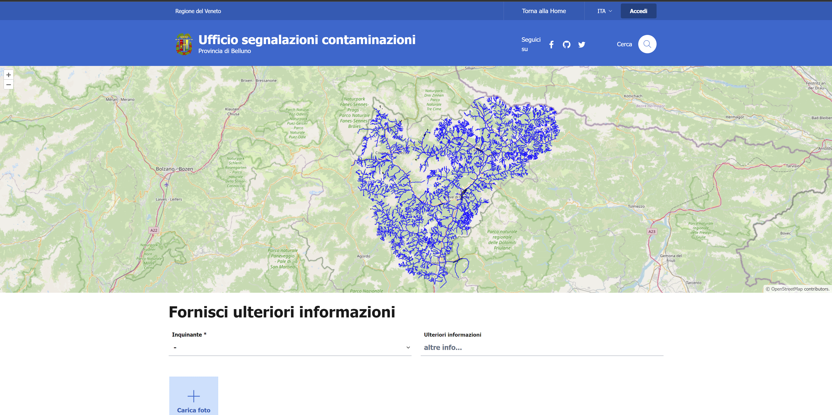
Front end website

Slide 14
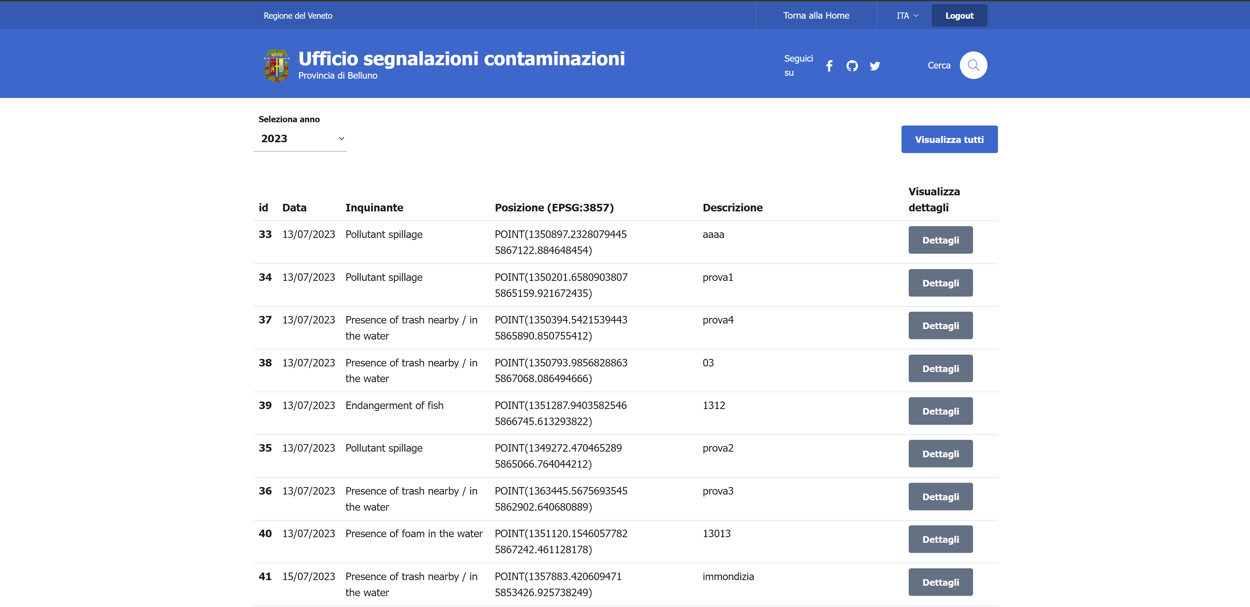
Backend website

Slide 15
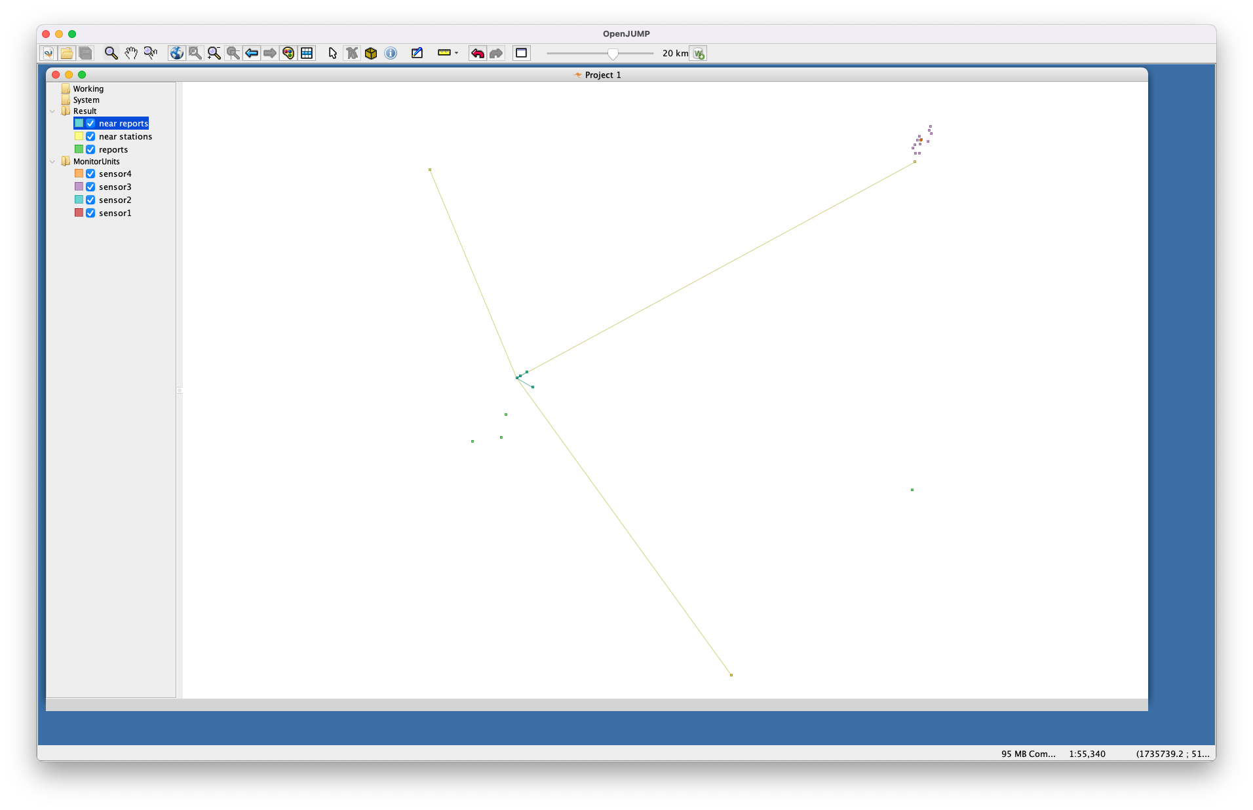
Open Jump plugin
The technician insert username e password for the database
The technician selects a report
The plugin finds the nearest tree monitor units (two upstream and one downstream) and connects them with a line to the report, and outputs in “result/near stations”
The plugin finds all the reports in a range of 500m and connects them to the selected report and outputs in “result/near reports”

Slide 16
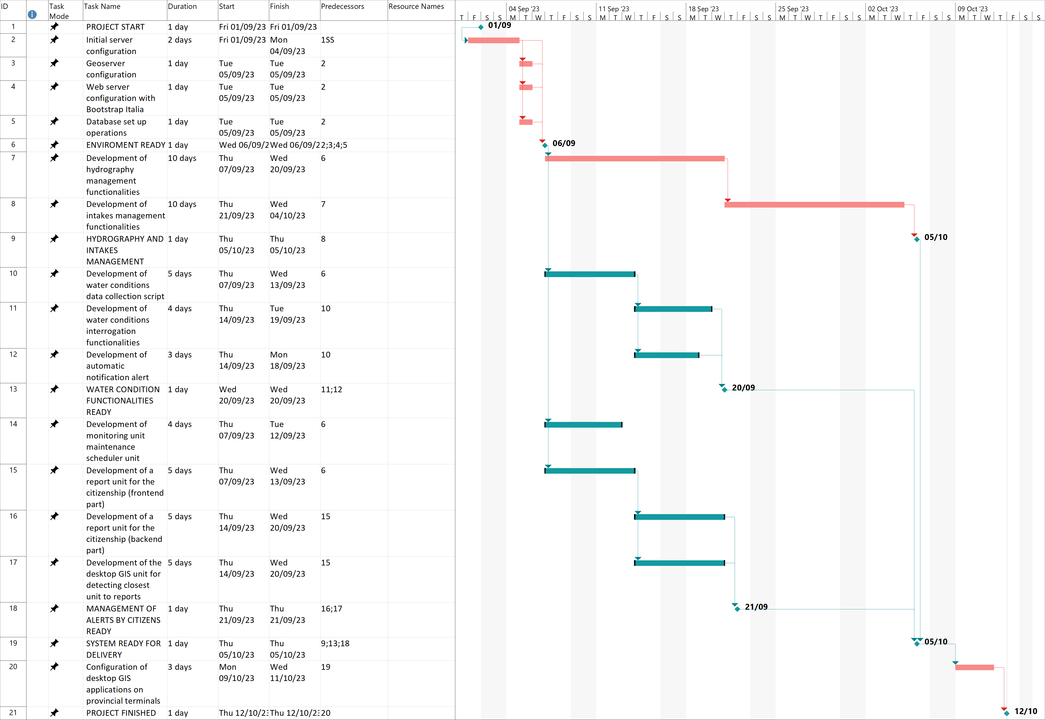
Time schedule

Slide 17
Costs
ACTIVITY | UNIT COST | QUANTITY | TOTAL
VIRTUAL SERVER ACTIVATION | 250€ | 1 | 250€
SERVER CONFIGURATION | 40€ | 40h | 1.600€
WEB DEVELOPING | 55€ | 304h | 16.720€
DESKTOP PLUGINS DEVELOPMENT | 45€ | 40h | 1.800€
DATA READER SCRIPT FROM MONITORING UNITS | 45€ | 64h | 2.880€
CONFIGURATION OF DESKTOP GIS ENVIRONMENT | 40€ | 24h | 960€
TOTAL |  |  | 24.210€

Slide 18
LIVE DEMO!
gis2023.bitsei.it

Slide 19
Tank you for your attention
GIS project By Cazzaro Mirco and Boscolo Nicola

